Slide 1
Manufacturing Technology (ME461)
Date: 19/1/2018
Instructor: Shantanu Bhattacharya

Slide 2
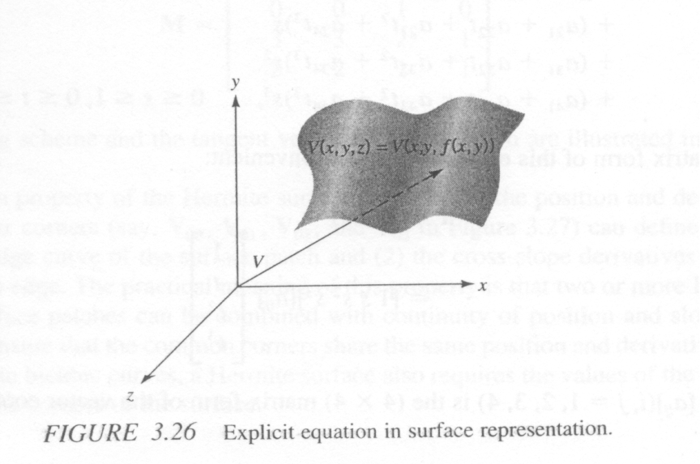
Surface representations
In case of curves we have seen the representation of curves by implicit/explicit equations.
Implicit equation to describe a surface:
F(x, y, z) = 0, Its geometric meaning is that the locus of points that satisfy the constraint equation defines the surface.
Explicit equation to describe a surface:
V = [x,y,z]^{T} = [x,y,f(x,y)] ^{T} where V is the position of a variable point on the surface. In this equation, we directly define the variable oint coordinates x,y,z. The z-coordinates of the position vector of the variable points are defined by x,y through a suitable function f(x,y) as shown in the figure below.
Comparing the equations for a 2-D curve and a 3-D surface the only difference between a space curve and a surface mathematically is that points on a space curve are defined by a single degree of freedom by that on a surface have two degrees of freedom.
Usually an arbitrary surface is defined in x,y with a functional relation f(x,y) by an x-y grid with P+1.Q+1 points.

Slide 3
Parametric Equation/ Representation of a Surface/ synthetic surface
There are no extra parameters in equations represented earlier and as such these are called non-parametric representation of equations. The corresponding equations that utilize parameters are called parametric equations and have two degrees of freedom and are represented as :
V(s,t) = [x,y,z]^{T} = [X(s,t), Y(s,t), Z(s,t)]^{T} , s_{min}< s< s_{max ,} t_{min}< t< t_{max}
Where x,y and z are functions of two parameters ‘s’ and ‘t’.
Hermite bicubic surface: Surfaces are normally defined in patches, each patch corresponds to a rectangular domain in s-t space, just as we discussed the s-domain in the previous section. Surface patches are dealt with in the same way; however, patches are much more complicated than segments.
Just as there is a characteristic third order equation to describe a two dimensional curve there is a third order 16 term series used to describe the cubic parametric equation for a surface.

Slide 4
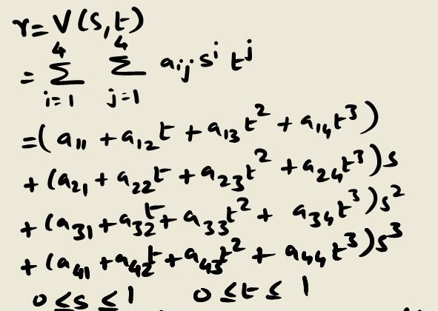
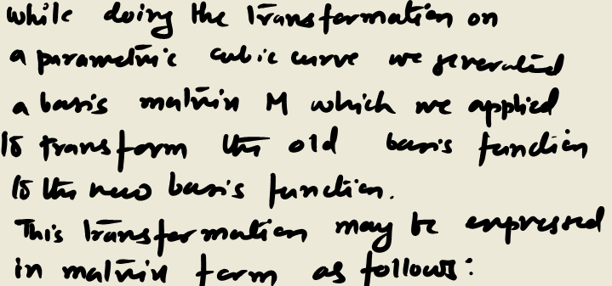
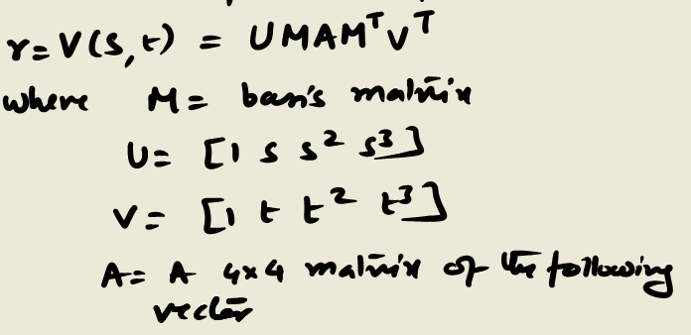
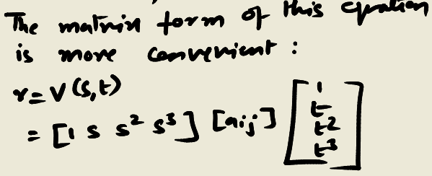
Parametric representation of surface

Slide 5
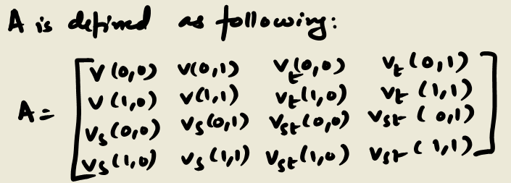
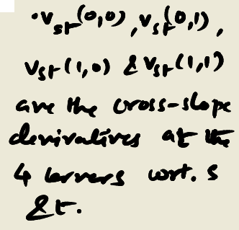
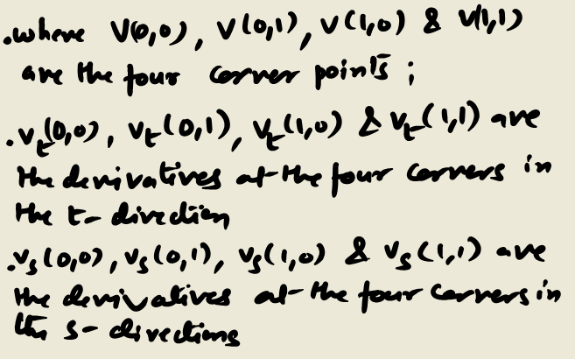
Parametric representation of a surface

Slide 6
Surface Manipulations
Various surface manipulation techniques are available in CAD/CAM systems.
Displaying: The simplest and most widely used method is to display a surface by a mesh of curves. This is usually called mesh in a CAD software. By holding one parameter constant at a time, a mesh of curves is generated to represent a surface which are displayed. Shading of a surface are also available in many CAD/CAM systems, which gives the displayed objects a realistic image.
Trimming and segmentation: Segmentation and trimming is essentially a problem of representing an entity by its particular portion as required. For example, if we want to show a particular partition of a surface on a screen or get a portrait on a printer or for editing purposes, the surface is split first and then the required part is displayed and the rest is blanked.
Intersection: This function is usually provided in CAD/CAM systems. Various curves may result when two general surface intersect. This also serves as a way to define a curve.
Projection: Projecting an entity onto a plane or surface is basically the problem of projecting a point to plane or surface. When a curve or surface is projected, the point projections are performed repeatedly. This function is used in determining shadows of entities.
Transformation: As with the curve transformation we can translate, rotate, mirror and scale a surface in most CAD/CAM systems. To transform a surface, the control points of the surface are evaluated and then transformed to a new position or orientation and the new object is reconstructed using the transformed position coordinates.

Slide 7
CAD/ CAM data exchange
It is common knowledge that the primary cause of data sharing problems between two or more systems is software incompatibility.
This is due to the fact that vendors of computer applications design different proprietary formats to store the data required and produced by their systems.
There are two solutions one of which is to develop the systems in a way that they are compatible with each other, in which case the two commercial products are integrated and the second is to have a neutral data exchange format for the purposes of data sharing.
By neutral file, we mean that the file has a format that can be utilized by various systems.
Notes:
For example, to realize a product physically, we first have to design the product. The design information is stored in data files, some of which may be in form of shape and size of the product. This information should be available to the manufacturer planning to develop process plans and manufacture the product. However, this will not be possible if manufacturer planning to develop process plans and manufacture the product. However, this will not be possible if the manufacturing planning system cannot read the CAD file.

Slide 8
Translation Strategies
In a direct translation strategy, one translator is capable only of translating the information of one pair of systems.
If we have N systems, every system has to have N-1 translators installed in order to input the database of any other system created.
The total no. of translators needed would then be N(N-1).
Moreover, the strategy is so complicated that it is almost impossible for a system to transfer data to all other systems.

Slide 9
Translation Strategies
In the indirect strategy, a neutral database structure is created. “Neutral” means that the file format is independent of different formats utilized by the various CAD/CAM system vendors.
With this strategy, each system needs only to have a preprocessor and a post processor to transfer the database universally. The function of a preprocessor is to translate the neutral file format database to the system’s own database format when the system is reading the database .
The function of a post processor is to translate the given database format to neutral file format when output is made. In this strategy, N CAD/CAM systems will need only 2N translators. However, indirect translating is usually slower than direct translating.
A successful data exchange format or standard or neutral file must meet a minimum set of requirements. The standard must cover the common entities, such as wireframe and surface entities, used in various modeling systems.
The standard format has to be compact, which may help achieve faster storage and retrieval; i.e., higher speed in converting data to and from the neutral format and smaller size resulting neutral file.
Among many standards available today, the IGES and PDES standards are the most widely used.

Slide 10
IGES (Initial graphics exchange specification)
This was first published in 1980 and later updated in 1983, 86, 88 and 1990. It is the first widely accepted standard exchange format used to communicate a modeling database among dissimilar CAD/CAM systems.
In fact IGES has been used for supplying data between suppliers and customers, as a means to create model of objects etc.
The basic elements of IGES are entities we have discussed in previous sections. Therefore, the format of the data is basically a description of entities. In IGES, each entity is assigned a number.
Numbers 1 through 599 and 700 through 5000 are allotted for specific assignments, and 600 through 699 and 10,000 through 99,999 are for user defined entities.
Entities are classified as geometric entities (such as shape, curve, surface) and non geometric entities (such as relation between various entities).
The geometric entities are described via two distinct but related Cartesian coordinate systems, namely, the model space coordinate system (MCS) or local coordinate system (W-workingCS).
Notes:
Assignments can be annotations like angles (#202) or diameter dimensions (#206) or some approximate conversions that are made to replace the target entities by the closest avialable entities. Like a native B-Spline of degree 1-7 must be replaced by two entities native B-Splines of degree 1-3 (#112) and 4-7 (#126) respectively.

Slide 11
PDES (Product data exchange standard)
The international organization for standardization (ISO) is currently involved in developing an international standard called STEP (Standard for transfer and exchange of product model data).
STEP is a step for global standardization of exchange of information related to automated manufacturing and results in the PDES.
The fundamental differences between IGES and PDES is that the IGES utilizes the basic entities as elements of the design whereas PDES data exchange is done in terms of applications.
This philosophy is also called mental models and is reflected in the PDES three layer architecture: Application layer-Interface between user and PDES in which the application model is explicitly expressed and the description and information are expressed, Logical layer which is used to provide a consistent and computer independent description, Physical layer which takes care of the structure of the data and its format of the exchange file.
Notes:
The logical layer is used to ensure that the logical layer is having ‘0’ redundancy and sufficiency in the information.

Slide 12
Drawing Exchange File format
DXF has been developed by Auto desk inc. to assist in interchange of drawings between AutoCAD and other programs.
The overall organization of DXF is as follows:
Header section: general information about the drawing.
Tables section: Definitions of named items.
Blocks section: Describe the entities constituting each block in the drawing.
Entities section: The drawing entities, including any block references.
END OF FILE

